Slide 1
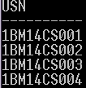
SQL select statement
student Table
usn | name | dep_num | marks
1BM14CS001 | Avinash | 10 | 100
1BM14CS002 | Balaji | 10 | 80
1BM14CS003 | Chandan | 10 | 45
1BM14CS004 | Dinesh | 10 | 60
1BM14IS005 | Avinash | 20 | 90
department Table
d_id | dep_name
10 | CSE
20 | ISE
Question
List out the USN’s of the students who belong to CSE department ?
Notes:
Select usn

Slide 2
SQL select statement
student Table
usn | name | dep_num | marks
1BM14CS001 | Avinash | 10 | 100
1BM14CS002 | Balaji | 10 | 80
1BM14CS003 | Chandan | 10 | 45
1BM14CS004 | Dinesh | 10 | 60
1BM14IS005 | Avinash | 20 | 90
department Table
d_id | dep_name
10 | CSE
20 | ISE
Notes:
Select usn

Slide 3
SQL select statement: Aliasing
student Table
usn | name | dep_num | marks
1BM14CS001 | Avinash | 10 | 100
1BM14CS002 | Balaji | 10 | 80
1BM14CS003 | Chandan | 10 | 45
1BM14CS004 | Dinesh | 10 | 60
1BM14IS005 | Avinash | 20 | 90
department Table
d_id | dep_name
10 | CSE
20 | ISE
Notes:
select usn from student as s, department as d where s.dep_num=d.d_id and d.dep_name=‘CSE’;

Slide 4
SQL select statement: Distinct
Student Table
usn | name | dep_num | marks
1BM14CS001 | Avinash | 10 | 100
1BM14CS002 | Balaji | 10 | 80
1BM14CS003 | Chandan | 10 | 45
1BM14CS004 | Dinesh | 10 | 60
1BM14IS001 | Avinash | 20 | 90
Avinash
Balaji
Chandan
Dinesh
Avinash

Slide 5
SQL select statement: Distinct
Student Table
usn | name | dep_num | marks
1BM14CS001 | Avinash | 10 | 100
1BM14CS002 | Balaji | 10 | 80
1BM14CS003 | Chandan | 10 | 45
1BM14CS004 | Dinesh | 10 | 60
1BM14IS001 | Avinash | 20 | 90
Avinash
Balaji
Chandan
Dinesh

Slide 6
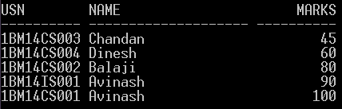
SQL select statement: Order By
Student Table
usn | name | dep_num | marks
1BM14CS001 | Avinash | 10 | 100
1BM14CS002 | Balaji | 10 | 80
1BM14CS003 | Chandan | 10 | 45
1BM14CS004 | Dinesh | 10 | 60
1BM14IS001 | Avinash | 20 | 90

Slide 7
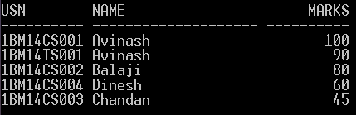
SQL select statement: Order By
Student Table
usn | name | dep_num | marks
1BM14CS001 | Avinash | 10 | 100
1BM14CS002 | Balaji | 10 | 80
1BM14CS003 | Chandan | 10 | 45
1BM14CS004 | Dinesh | 10 | 60
1BM14IS001 | Avinash | 20 | 90

Slide 8
SQL select statement: Order By
Student Table
usn | name | dep_num | marks
1BM14CS001 | Avinash | 10 | 100
1BM14CS002 | Balaji | 10 | 80
1BM14CS003 | Chandan | 10 | 45
1BM14CS004 | Dinesh | 10 | 60
1BM14IS001 | Avinash | 20 | 90
Question
List usn, name of the students who belong to department number 10 ordered by
ascending order of their marks ?
Notes:
List usn, name of the students who belong to department number 10 ordered by ascending order of their marks ?

Slide 9
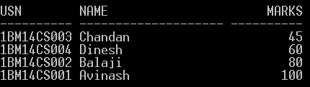
SQL select statement: Order By
Student Table
usn | name | dep_num | marks
1BM14CS001 | Avinash | 10 | 100
1BM14CS002 | Balaji | 10 | 80
1BM14CS003 | Chandan | 10 | 45
1BM14CS004 | Dinesh | 10 | 60
1BM14IS001 | Avinash | 20 | 90
Question
List usn, name of the students who belong to department number 10 ordered by
ascending order of their marks ?
Notes:
List usn, name of the students who belong to department number 10 ordered by ascending order of their marks ?

Slide 10
Activity: To do
Employee table
EMPNO | ENAME | JOB | MGR | HIREDATE | SAL | COMM | DEPTNO
7369 | SMITH | CLERK | 7902 | 17-Dec-80 | 800 |  | 20
7499 | ALLEN | SALESMAN | 7698 | 20-Feb-81 | 1600 | 300 | 30
7521 | WARD | SALESMAN | 7698 | 22-Feb-81 | 1250 | 500 | 30
7566 | JONES | MANAGER | 7839 | 02-Apr-81 | 2975 |  | 20
7654 | MARTIN | SALESMAN | 7698 | 28-Sep-81 | 1250 | 1400 | 30
7698 | BLAKE | MANAGER | 7839 | 01-May-81 | 2850 |  | 30
7782 | CLARK | MANAGER | 7839 | 09-Jun-81 | 2450 |  | 10
7788 | SCOTT | ANALYST | 7566 | 09-Dec-82 | 3000 |  | 20
7839 | KING | PRESIDENT |  | 17-Nov-81 | 5000 |  | 10
7844 | TURNER | SALESMAN | 7698 | 08-Sep-81 | 1500 | 0 | 30
7876 | ADAMS | CLERK | 7788 | 12-Jan-83 | 1100 |  | 20
7900 | JAMES | CLERK | 7698 | 03-Dec-81 | 950 |  | 30
7902 | FORD | ANALYST | 7566 | 03-Dec-81 | 3000 |  | 20
7934 | MILLER | CLERK | 7782 | 23-Jan-82 | 1300 |  | 10
Write SQL queries for the following
Display all the information of the Employee table ?
Display unique Jobs from Employee table?
List names of the employees in the ascending order of their Salaries ?
Notes:
Display all the information of the EMP table?
A) select * from emp;
Display unique Jobs from EMP table?
select distinct job from emp;
select unique job from emp;
List the emps in the asc order of their Salaries?
A) select * from emp order by sal asc;

Slide 11
Topics Covered in Today’s class
Unit 1: Basic queries in SQL
w.r.t SELECT statement
SQL operators: LIKE, IN, BETWEEN

Slide 12
Structured Query Language (SQL)
SQL can be divided into two parts:
1. The Data Manipulation Language (DML) and
2. The Data Definition Language (DDL)
1. DDL statements in SQL are:
CREATE DATABASE - creates a new database
ALTER DATABASE - modifies a database
CREATE TABLE - creates a new table
ALTER TABLE - modifies a table
DROP TABLE - deletes a table
2. DML part of SQL:
SELECT - extracts data from a database
UPDATE - updates data in a database
DELETE - deletes data from a database
INSERT INTO - inserts new data into a database

Slide 13
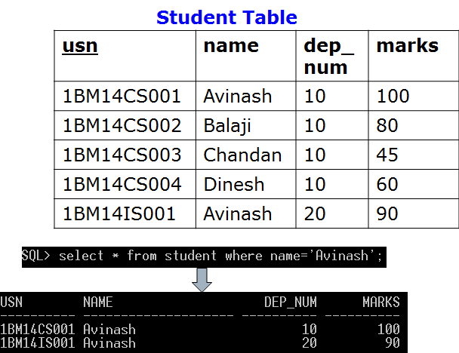
The SQL SELECT Statement
The SELECT statement is used to select data from a database.
The result is stored in a result table, called the result-set.
Note: SQL is not case sensitive. SELECT is the same as select.

Slide 14
w.r.t to SELECT SQL statement
1. SQL Alias: We can give a table or a column another name by using an alias.
SQL Alias Syntax for Tables
SELECT column_name(s)
FROM table_name AS alias_name;
SQL Alias Syntax for Columns
SELECT column_name AS alias_name
FROM table_name;
2. The DISTINCT keyword can be used to return only distinct (different) values.
SQL SELECT DISTINCT Syntax
SELECT DISTINCT column_name(s)
FROM table_name

Slide 15
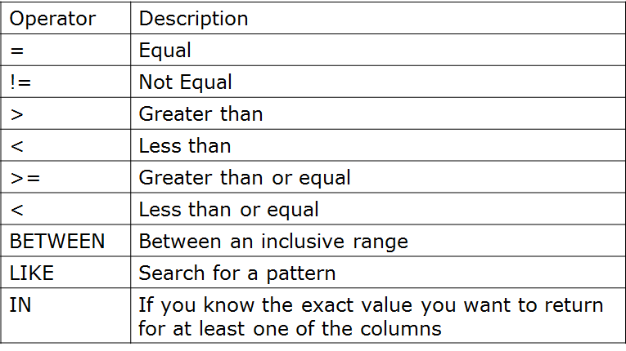
w.r.t to SELECT sql statement
3. The ORDER BY keyword is used to sort the result-set by a specified column.
SQL ORDER BY Syntax
SELECT column_name(s)
FROM table_name
ORDER BY column_name(s) ASC | DESC;
4. The WHERE clause is used to filter records. The WHERE clause is used to extract only those records that fulfill a specified criterion.
SQL WHERE Syntax
SELECT column_name(s)
FROM table_name
WHERE column_name operator value
With the WHERE clause, the following operators can be used:

Slide 16
Substring Pattern Matching: SQL LIKE Operator
The LIKE operator is used in a WHERE clause to search for a specified pattern in a column.
SQL LIKE Syntax
SELECT column_name(s)
FROM table_name
WHERE column_name LIKE pattern

Slide 17
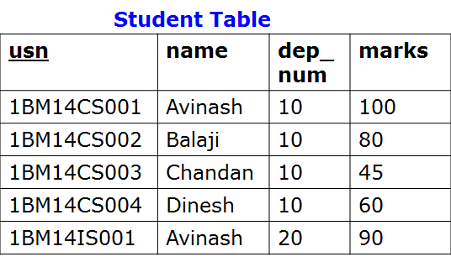
SQL LIKE Operator
The LIKE operator is used in a WHERE clause to search for a specified pattern in a column.
SQL LIKE Syntax
SELECT column_name(s)
FROM table_name
WHERE column_name LIKE pattern
Example: Write SQL statement to list the names starting with letter “A” from following student table.

Slide 18


SQL LIKE Operator
Write SQL statement to list the names starting with letter “A” from the following student table.

Slide 19
SQL LIKE Operator
Write SQL statement to list the names starting with letter “A” from the following student table.
Note:
Wildcard character %, A substitute for zero or more characters
Notes:
Case Sensitivity Case is significant in all conditions comparing character expressions that the LIKE condition and the equality (=) operators. You can use the UPPER function to perform a case-insensitive match, as in this condition:
UPPER(last_name) LIKE 'SM%'

Slide 20
SQL LIKE Operator
Question
Write SQL statement to list name of the students whose names end
with letter ‘h’?
Note:
Wildcard character %, A substitute for zero or more characters

Slide 21

SQL LIKE Operator
Question
Write SQL statement to list name of the students whose names end
with letter ‘h’?

Slide 22
SQL LIKE Operator
Question
Write SQL statement to list name of the students whose names
are having the substring ‘in’?
Note:
Wildcard character %, A substitute for zero or more characters

Slide 23

SQL LIKE Operator
Question
Write SQL statement to list name of the students whose names
are having the substring ‘in’?

Slide 24
SQL LIKE Operator
Question
Write SQL statement to list name of the students whose names
start with letter ‘A’ or ‘B’

Slide 25

SQL LIKE Operator
Question
Write SQL statement to list name of the students whose names
start with letter ‘A’ or ‘B’

Slide 26
SQL LIKE Operator
Question
Write SQL statement to list name of the students whose names
start with letter ‘A’ or ‘D’ but end with letter ‘h’

Slide 27

SQL LIKE Operator
Question
Write SQL statement to list name of the students whose names
start with letter ‘A’ or ‘D’ but end with letter ‘h’

Slide 28
SQL LIKE Operator
Question
Write SQL statement to list name of the students whose third letter in the
name is ‘a’ .

Slide 29

SQL LIKE Operator
Question
Write SQL statement to list name of the students whose third letter in the
name is ‘a’ .
Note:
An underscore (_) in the pattern matches exactly one character
A percent sign (%) in the pattern can match zero or more characters
underscore (_) and percent sign (%) are referred as wildcard characters

Slide 30
SQL Wildcard Characters
In SQL, wildcard characters are used with the SQL LIKE operator.
SQL wildcards are used to search for data within a table.
With SQL, the wildcards are:
Wildcard | Description
% | A substitute for zero or more characters
_ | A substitute for a single character
[charlist] | Sets and ranges of characters to match
[^charlist] or [!charlist] | Matches only a character NOT specified within the brackets
Notes:
The pattern can contain special pattern-matching characters:
An underscore (_) in the pattern matches exactly one character
A percent sign (%) in the pattern can match zero or more characters

Slide 31
SQL IN Operator
The IN operator allows you to specify multiple values in a WHERE clause.
SQL IN Syntax
SELECT column_name(s)
FROM table_name
WHERE column_name IN (value1,value2,...)

Slide 32
SQL IN Operator
The IN operator allows you to specify multiple values in a WHERE clause.
SQL IN Syntax
SELECT column_name(s)
FROM table_name
WHERE column_name IN (value1,value2,...)
Example: List USN's of the students with name equal to "Avinash" or "Dinesh" from the table above.

Slide 33

SQL IN Operator
The IN operator allows you to specify multiple values in a WHERE clause.
Example: List USN's of the students with name equal to "Avinash" or "Dinesh" from the table above.

Slide 34
SQL BETWEEN operator
The BETWEEN operator selects a range of data between two values. The values can be numbers, text, or dates.
SQL BETWEEN Syntax
SELECT column_name(s)
FROM table_name
WHERE column_name BETWEEN value1 AND value2
Example: List USN’s and Names of students whose marks is in between 40 and 80

Slide 35

SQL BETWEEN operator
The BETWEEN operator selects a range of data between two values. The values can be numbers, text, or dates.
Example: List USN’s and Names of students whose marks is in between 40 and 80

Slide 36
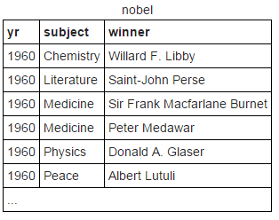
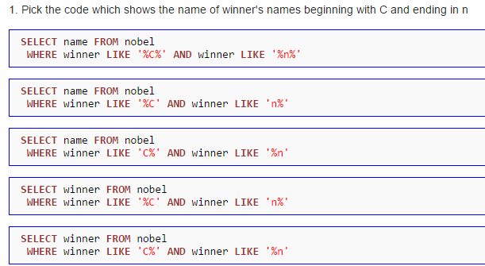
Activity To Do
Consider table of Nobel prize winners:
nobel(yr, subject, winner)
Answer the following

Slide 37
Activity To Do
Consider table of Nobel prize winners:
nobel(yr, subject, winner)
Answer the following

Slide 38
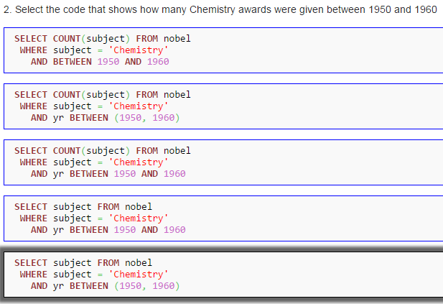
Activity To Do
Consider table of Nobel prize winners:
nobel(yr, subject, winner)
Answer the following

Slide 39
Activity To Do
Consider table of Nobel prize winners:
nobel(yr, subject, winner)
Answer the following

Slide 40
Aggregate Functions in SQL
Why we need aggregate functions ??
Example say we want find maximum marks scored by the students in the class.
We use aggregate function to group multiple rows together to form a single value output.

Slide 41
Topics Covered in Todays Class
Unit 1: Basic queries in SQL
Aggregate functions
Group BY Clause
Having Clause

Slide 42

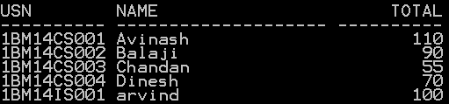
Arithmetic operators in Queries
Arithmetic operators for addition (+), subtraction (-), multiplication(*), and division (/) can be applied to numeric values or attributes with numeric domain.
Example:

Slide 43
Aggregate Functions in SQL
SQL aggregate functions return a single value, calculated from values in a column.
Useful aggregate functions:
AVG() - Returns the average value
COUNT() - Returns the number of rows
MAX() - Returns the largest value
MIN() - Returns the smallest value
SUM() - Returns the sum

Slide 44

Aggregate Functions in SQL
The AVG() Function
The AVG() function returns the average value of a numeric column.
SQL AVG() Syntax
SELECT AVG(column_name) FROM table_name
Find average marks of all the students in the class.

Slide 45
Aggregate Functions in SQL
SQL COUNT() Function
The COUNT() function returns the number of rows that matches a specified
criteria.
SQL COUNT(column_name) Syntax
The COUNT(column_name) function returns the number of values (NULL
values will not be counted) of the specified column:
SELECT COUNT(column_name) FROM table_name
SQL COUNT(*) Syntax
The COUNT(*) function returns the number of records in a table:
SELECT COUNT(*) FROM table_name
SQL COUNT(DISTINCT column_name) Syntax
The COUNT(DISTINCT column_name) function returns the number of
distinct values of the specified column:
SELECT COUNT(DISTINCT column_name) FROM table_name

Slide 46

Aggregate Functions in SQL
SQL COUNT(*) Syntax
The COUNT(*) function returns the number of records in a table.
.
Find total number of records in the above student table

Slide 47

Aggregate Functions in SQL
SQL COUNT(*) Syntax
The COUNT(*) function returns the number of records in a table.
Find total number of students who belong to department number
10

Slide 48
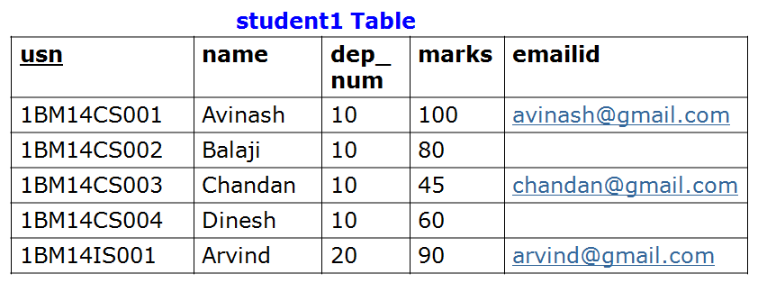

Aggregate Functions in SQL
SQL COUNT(column_name) Syntax
The COUNT(column_name) function returns the number of values
(NULL values will not be counted) of the specified column.
Find total number of students who have Email IDs

Slide 49
Aggregate Functions in SQL
What will be the out put of following SQL queries ?

Slide 50
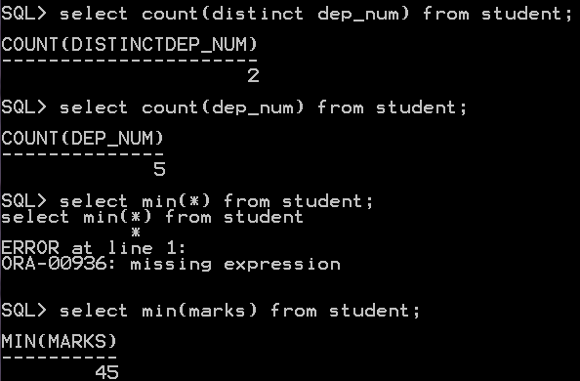
Aggregate Functions in SQL

